Slide 1
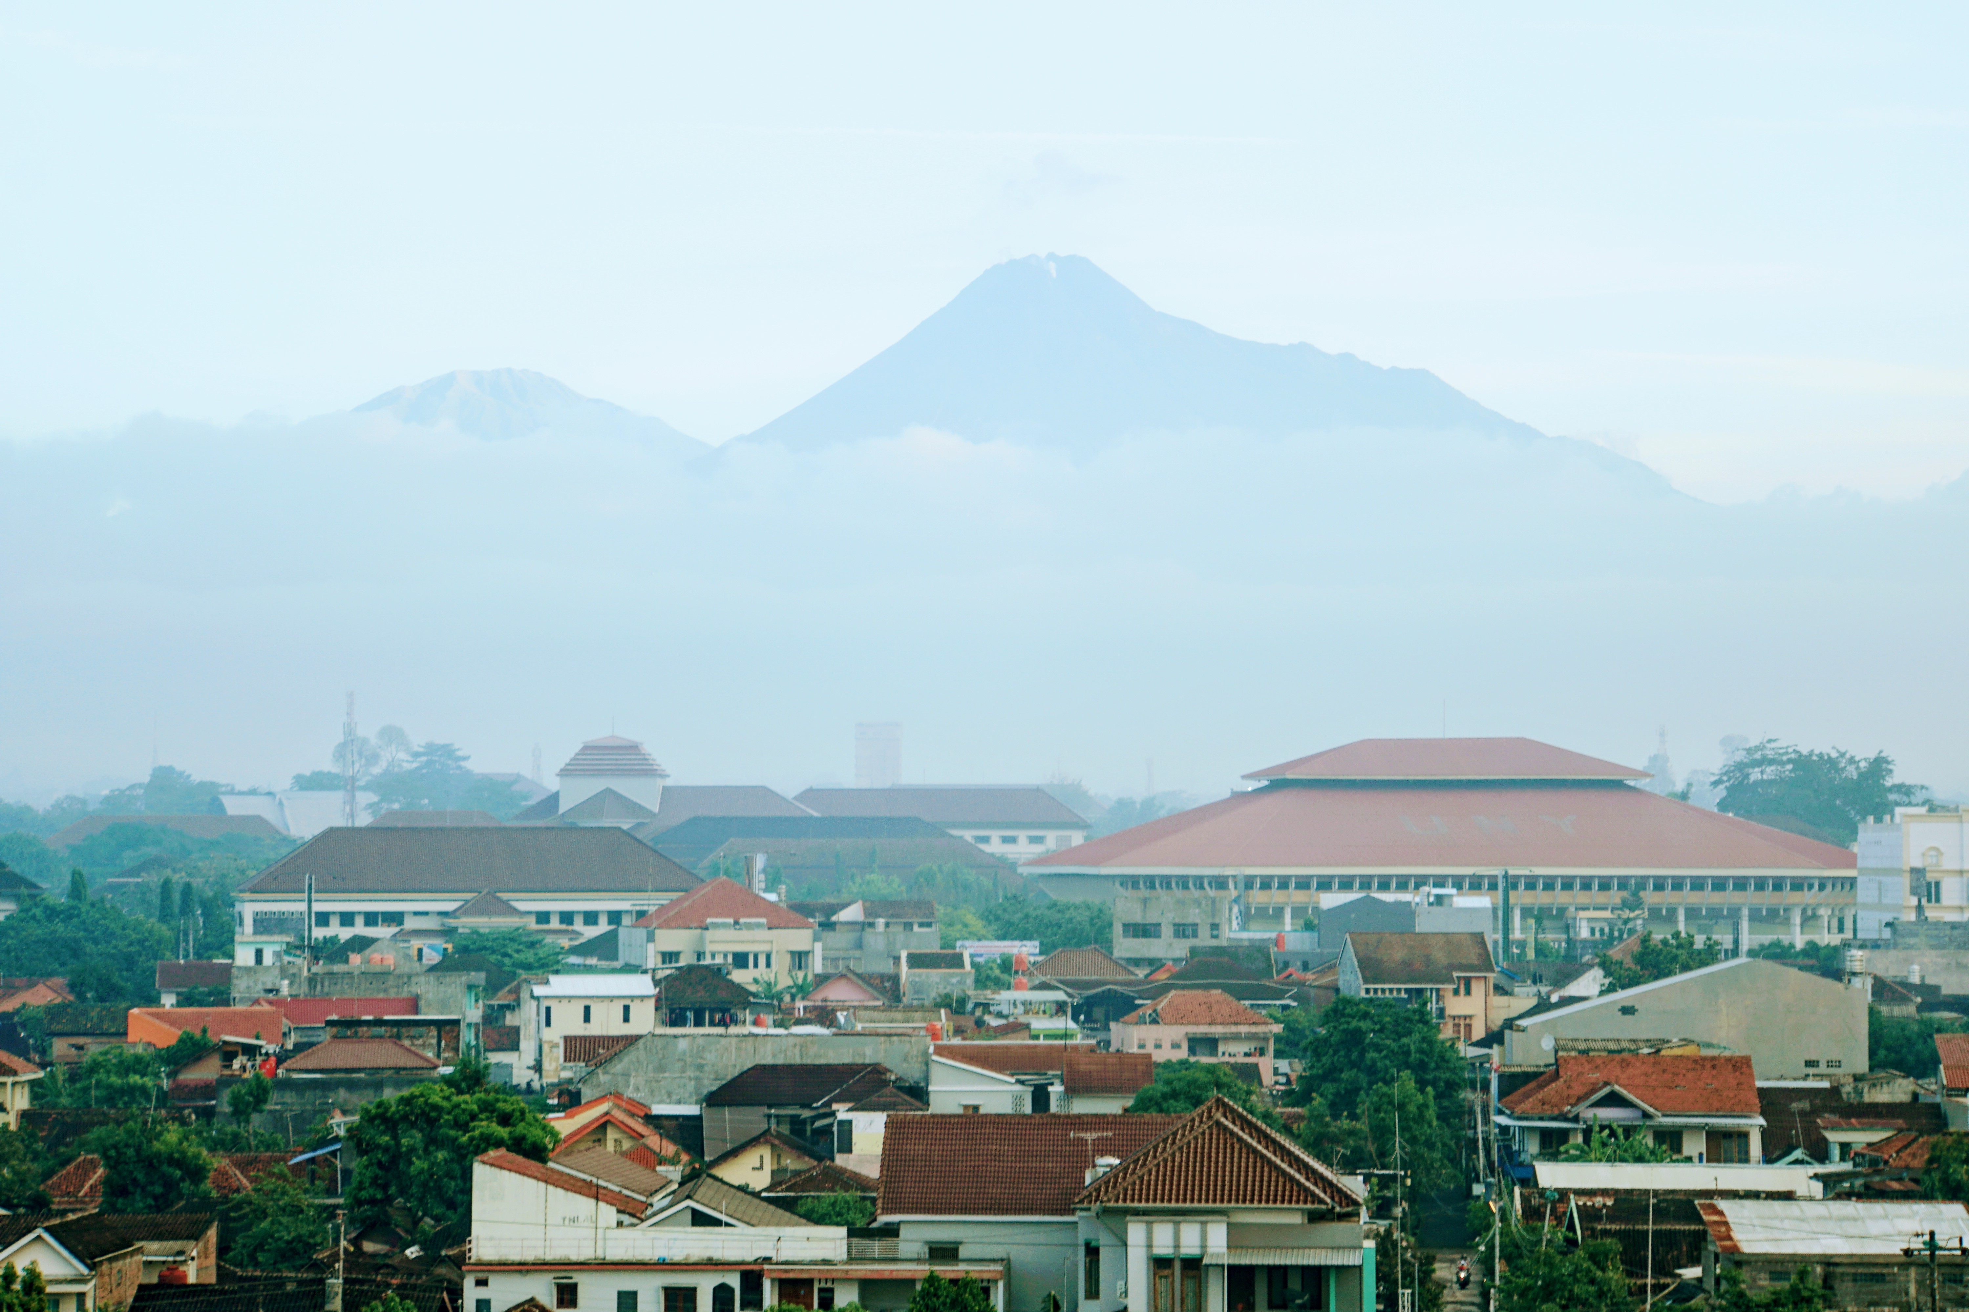

Modeling Volcanic Flows:
Lahars
Photo: S. Ogburn
Notes:
And finally I’d like to float some ideas to you all regarding potential community efforts for best practices for PDC data. For example, the Tephra community has developed best practices for data collection as well as community resources such as the eruption source parameter database. There also seems to be room for leveraging global databases for some of the model benchmarking exercises that we’ll hear about later in this session. We’re hoping to develop FlowDat into more of a community resource for use in modeling in the coming years and to organize community meetings for input on such efforts.

Slide 2
Lahar/debris flow models
LAHARZ (Iverson et al. 1998): empirical model based on flow volume, inundated area, and maximum cross-sectional area
Flo2D (OBrien 1993): hydrodynamic model
TITAN2F (Cordoba et al. 2015): new two-phase flow version of TITAN2D
VolcFlow (Kelfoun & Druitt 2005): single and two-phase flow models
D-CLAW (George & Iverson 2014): two phase debris flow model with pore-fluid pressure, evolving volume fractions, etc.

Slide 3
Model | Citation | Description/notes | Availability | Count | Percent
LAHARZ (USGS) | Iverson et al. (1998); Schilling (1998); Schilling (2014) | Empirical/statistical model relating volume to planimetric/cross-sectional area | Free, open-source ArcGIS, standalone python, VICTOR | 149 | 71.2
FLO-2D | O'Brien (1993) | 2D depth averaged geophysical model; Bingham rheology; designed by engineers for floods, floods in urban environments | Commercial product license $ | 23 | 11.0
LaharFlow/MultiHaz | Woodhouse (in preparation); Tierz et al. (2017) | Depth-averaged geophysical model; two-phase, models erosion and deposition | In preparation | 6 | 2.9
HIMAT-FAO | HIMAT-FAO (1987) | ? | ? | 4 | 1.9
MatHaz | Bertin et al. (2019) | Multi-hazard model; steepest descent/volume-thickness model developed for lava flows, modified for lahars | Free, open-source, available on GitHub | 3 | 1.4
DAMBRK/SMPDBK | Fread (1984); Wetmore & Fread (1991) | Designed for dam-break floods from failed reservoir; models flood peak elevation, travel time using flow routing algorithm | Free, open-source, unclear if still supported | 2 | 0.9
HYDRAUX (USGS) | Hansen (1987); DeLong & Schoellhamer (1989) | 1D shallow water geophysical flow model | FORTRAN, open-source, no longer available/supported | 2 | 0.9
VolcFlow | Kelfoun & Druitt (2005) | Geophysical mass flow model developed for granular flows but with multiple rheology options for lahars, one-fluid and two-fluid options | Free, open-source but requires Matlab | 2 | 0.9
Unnamed cost-distance model | Barrantes Castillo & Malavassi Rojas (2015) | GIS-based cost-distance model that determines potential flow paths | Not available, but could implement method in any GIS | 1 | 0.48
Unnamed lahar model | Miyamoto & Ito (2003) | ? | ? | 1 | 0.48
Unnamed lahar travel time model | Pierson (1998) | Empirical lahar travel time model, does not model inundation | Equations relating flow volume, distance, and time available | 1 | 00.48
Unnamed mass flow model | Mastrolorenzo & Pappalardo (2010) | Geophysical mass flow model developed for granular flows but with multiple rheology options for lahars | Not available | 1 | 0.48

Slide 4
Model | Citation | Description/notes | Availability | Count | Percent
LAHARZ (USGS) | Iverson et al. (1998); Schilling (1998); Schilling (2014) | Empirical/statistical model relating volume to planimetric/cross-sectional area | Free, open-source ArcGIS, standalone python, VICTOR | 149 | 71.2
FLO-2D | O'Brien (1993) | 2D depth averaged geophysical model; Bingham rheology; designed by engineers for floods, floods in urban environments | Commercial product license $ | 23 | 11.0
LaharFlow/MultiHaz | Woodhouse (in preparation); Tierz et al. (2017) | Depth-averaged geophysical model; two-phase, models erosion and deposition | In preparation | 6 | 2.9
HIMAT-FAO | HIMAT-FAO (1987) | ? | ? | 4 | 1.9
MatHaz | Bertin et al. (2019) | Multi-hazard model; steepest descent/volume-thickness model developed for lava flows, modified for lahars | Free, open-source, available on GitHub | 3 | 1.4
DAMBRK/SMPDBK | Fread (1984); Wetmore & Fread (1991) | Designed for dam-break floods from failed reservoir; models flood peak elevation, travel time using flow routing algorithm | Free, open-source, unclear if still supported | 2 | 0.9
HYDRAUX (USGS) | Hansen (1987); DeLong & Schoellhamer (1989) | 1D shallow water geophysical flow model | FORTRAN, open-source, no longer available/supported | 2 | 0.9
VolcFlow | Kelfoun & Druitt (2005) | Geophysical mass flow model developed for granular flows but with multiple rheology options for lahars, one-fluid and two-fluid options | Free, open-source but requires Matlab | 2 | 0.9
Unnamed cost-distance model | Barrantes Castillo & Malavassi Rojas (2015) | GIS-based cost-distance model that determines potential flow paths | Not available, but could implement method in any GIS | 1 | 0.48
Unnamed lahar model | Miyamoto & Ito (2003) | ? | ? | 1 | 0.48
Unnamed lahar travel time model | Pierson (1998) | Empirical lahar travel time model, does not model inundation | Equations relating flow volume, distance, and time available | 1 | 00.48
Unnamed mass flow model | Mastrolorenzo & Pappalardo (2010) | Geophysical mass flow model developed for granular flows but with multiple rheology options for lahars | Not available | 1 | 0.48

Slide 5
Modeling volcanic flows
“All models are wrong, but some are useful” –statistician George Box
Different models are wrong in different ways (make different simplifications and assumptions)
Different models might be more wrong (or more useful) for certain questions, types of hazards, or situations
  One model might be better for simulating large PDCs than small PDCs, or one model might be better at simulating velocities while another is better at simulating inundation
  One model might be better if you only have a short amount of time, or if you have a poor quality DEM

Slide 6
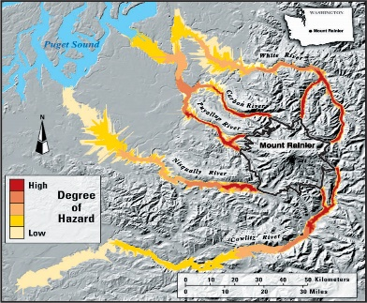
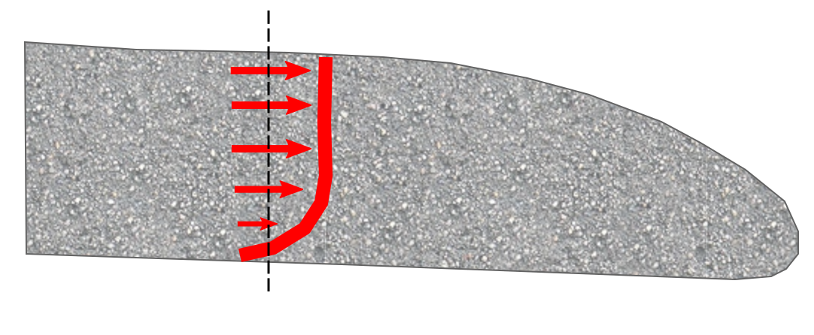
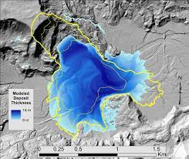
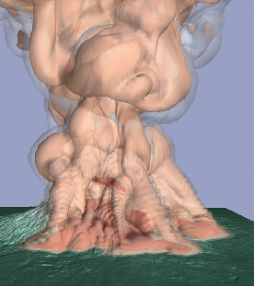
Statistics-based (Empirical)
Empirical models
-Based on local and global data
-Runout or inundated areas derived from statistical relationships with flow volume
-Ex: Energy cone (Malin & Sheridan, 1982),
FLOW2D (Sheridan & Macias, 1992),
LAHARZ (Iverson et al. 1998, Schilling et al. 2014)
Physics-based
Depth-averaged models
-Relatively thin, dense, concentrated flows
-Frictional interaction at the bed or constant retarding shear stress controls flow motion
-Ex: TITAN2D (Patra et al. 2005), VolcFlow (Kelfoun & Druitt , 2005)
Increasing complexity and computational time
Depth averaged velocity
Multiphase models
-Separate conservation equations for multiple particle types
-Drag between the gas and particles transmits momentum between phases
-Ex: PDAC (Ongaro et al. 2008), (Dufek & Bergantz 2007)
DCLAW (George et al. 2014

Slide 7
An example of different models
LAHARZ (statistical)
D-CLAW (physical)
Empirically based
Few model input parameters (DEM, stream network, start locations, volumes)
Vary volumes
Gives simple maps of probable lahar inundation for a given volume
Quick, not much computing power
Physical flow model
Many model input parameters (DEM, precise 3D source area, 8 different material properties)
Input parameters are very difficult to know ahead of time so must be varied with many simulations
Simulates dynamics of flows and gives inundation, velocity, pore pressure evolution
Computationally demanding

Slide 8
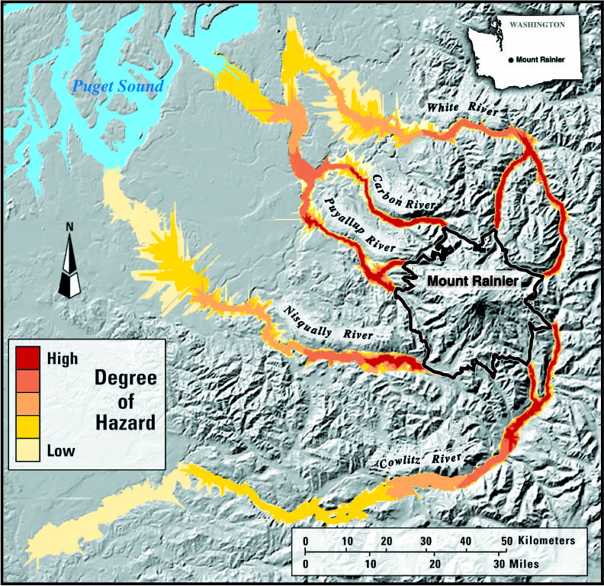
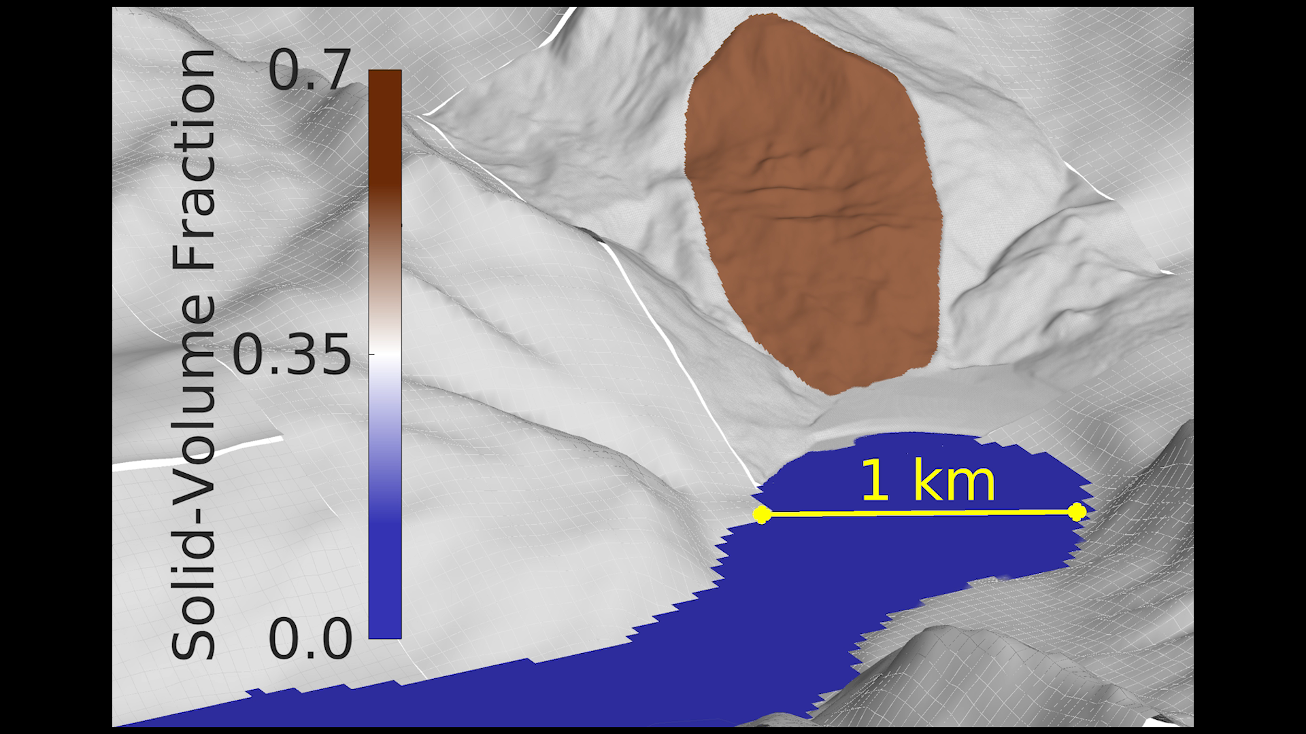
An example of different models
LAHARZ (statistical)
D-CLAW (physical)

Slide 9
Statistical models
(for example, LAHARZ for lahars, energy cone for PDCs)
Use statistical/empirical models like LAHARZ (for lahars) or energy cones (for PDCs) for rapid assessment and portrayal of hazard zones
Especially good for broad regions (such as an entire volcano) where considerable uncertainty exists about the locations and sizes of future flows.
Can run statistical models for the best-fit regression and the upper and lower confidence bounds to show the range of uncertainty (this is now a built-in option in LAHARZ) to reflect the effects of natural variability

Slide 10
Physical models
(for example, DCLAW for lahars, TITAN2D for PDCs)
Use physically-based models (like DCLAW) to perform more detailed hazard assessments where prior knowledge warrants, and/or the model has input parameters that are more easily estimated (TITAN2D).
Such models have great flexibility and explanatory power, but they also have more components—and more sources of uncertainty—than a simple statistical model such as LAHARZ or energy cones.
A physically based model like DCLAW such can have excellent explanatory power but still have limited predictive power. Other physical models with fewer input parameters (like TITAN2D for PDCs) are more easily used for forecasting.
Thus, they must be used carefully if they’re used in a hazard forecasting mode. One model run ≠ hazard map.

Slide 11
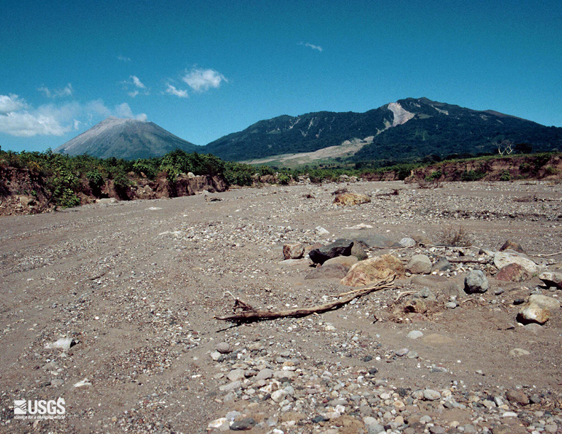
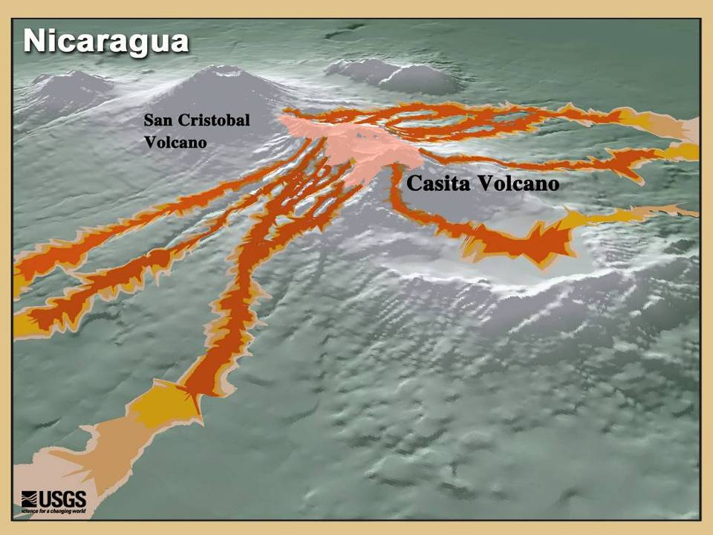
Forecasting lahar inundation
limits using LAHARZ
Casita Volcano 1998 lahar path

Slide 12
Acknowledgements
Many slides presented here are courtesy of Steve Schilling and Julie Griswold
Further reading:
  Schilling. 1998. LAHARZ: GIS programs for automated mapping of lahar-inundation hazard zones. USGS Open-File Report 98-638
  Iverson et al. 1998. Objective delineation of lahar-inundation hazard zones. Geological Society of America Bulletin, 110, 972-984
  Griswold & Iverson 2007. Mobility Statistics and Automated Hazard Mapping for Debris Flows and Rock Avalanches. USGS Scientific Investigations Report 2007–5276 Version 1.1
  Schilling. 2014. Laharz_py: GIS Tools for Automated Mapping of Lahar Inundation Hazard Zones. USGS Open-File Report 2014–1073

Slide 13
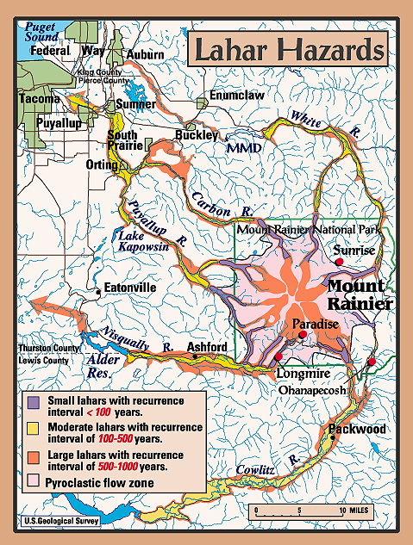
Objective, reproducible?
Map details send the wrong message?
What are we communicating?
Automated methods?
Access to remote areas?
Geologic history/maps completed?
Time during crisis for field work?

Slide 14
LAHARZ
Goal: a rapid, objective, reproducible method for forecasting lateral and distal inundation limits that define hazard zones
Guiding Philosophy: Global data on areas inundated by past lahars provide a basis for forecasting future inundation limits at particular locations

Slide 15
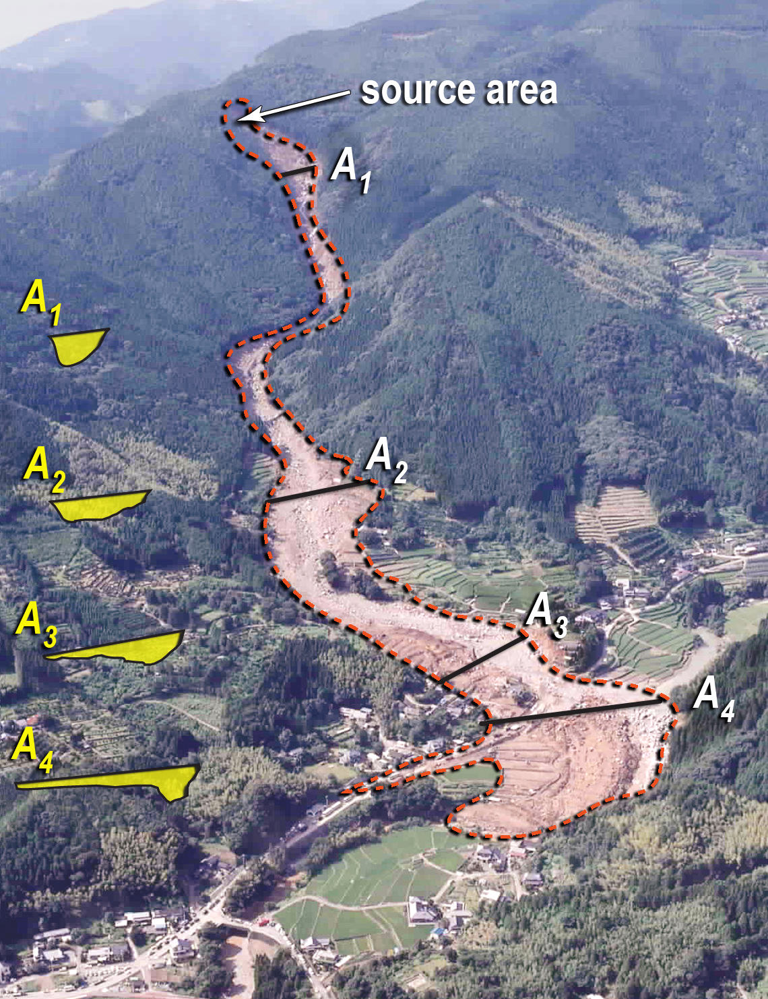
LAHARZ principles
1) inundation by past lahars provides a basis for predicting inundation by future lahars
2) distal lahar hazards are confined to valleys that start on volcano flanks
3) lahar volume largely controls the extent of inundation downstream
4) voluminous lahars occur less often than small lahars
5) no one can foretell the exact size of the next lahar to descend a given drainage
(Iverson et al., 1998).
A is maximum cross-
sectional area inundated
B
B is total planimetric area inundated

Slide 16
LAHARZ principles
Any flow advancing down-valley produces lateral and distal limits in other words:
cross-sectional (A) and planimetric (B) inundation areas that are influenced by topography and flow volume, V.
LAHARZ considers these two influences (topography and volume). The method uses three variables only: Volume (V), cross-sectional area (A), and planimetric area (B).
A is maximum cross-
sectional area inundated
B
B is total planimetric area inundated

Slide 17
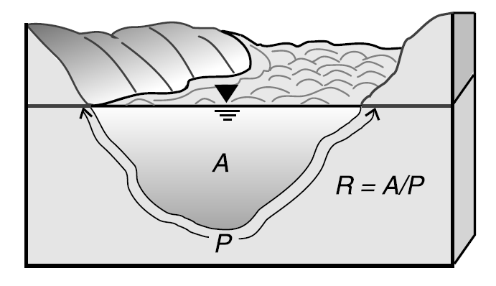
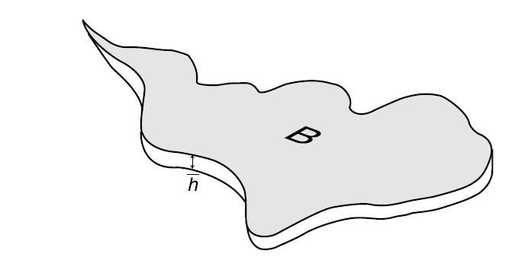
high-flow marks indicated by strandlines, levees, embedded gravels, or the height of stripped bark on the trunks of adjacent trees, and the height of log jams.
LAHARZ equations:
Use past events to forecast future events
Cross-sectional and planimetric area of inundation are proportional to flow volume^{2/3}
The coefficients c₁ and c₂ are determined from measuring the maximum cross-sectional area, planimetric area, and volume of many flows and performing regression analysis
Max cross-sectional area (A) = c₁V ^{2/3}
lateral limits of any evidence of high-flow lines.
Total planimetric area = c₂V ^{2/3}

Slide 18
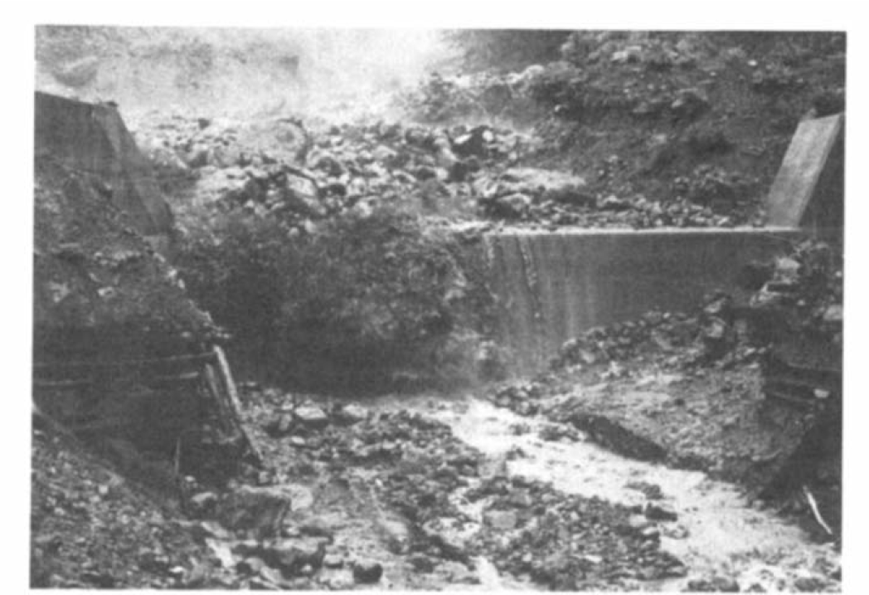
Takahashi, 1981

Slide 19
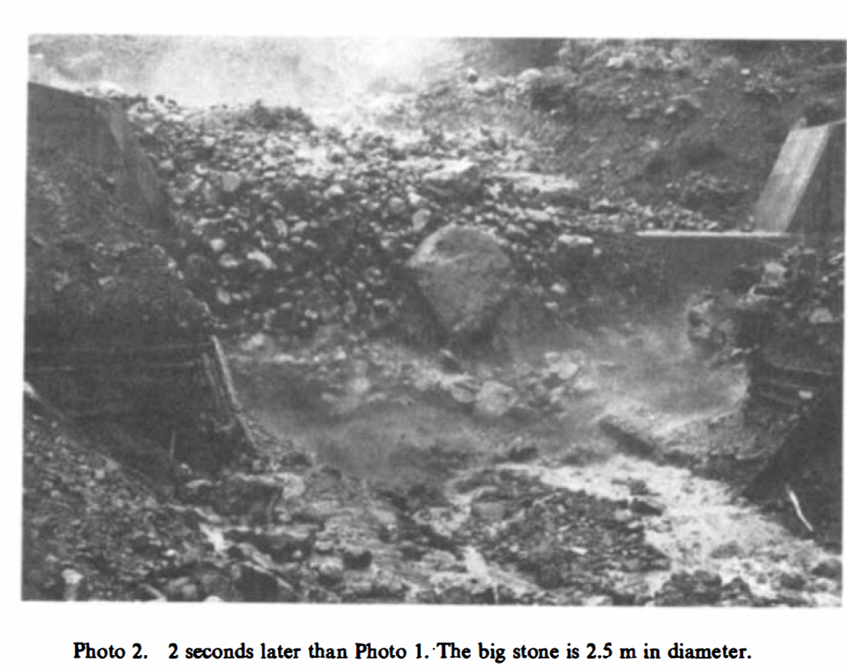
Takahashi, 1981

Slide 20
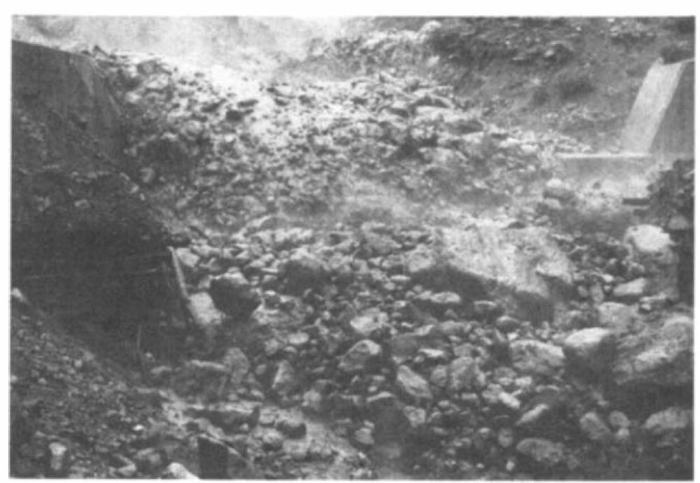
Takahashi, 1981

Slide 21
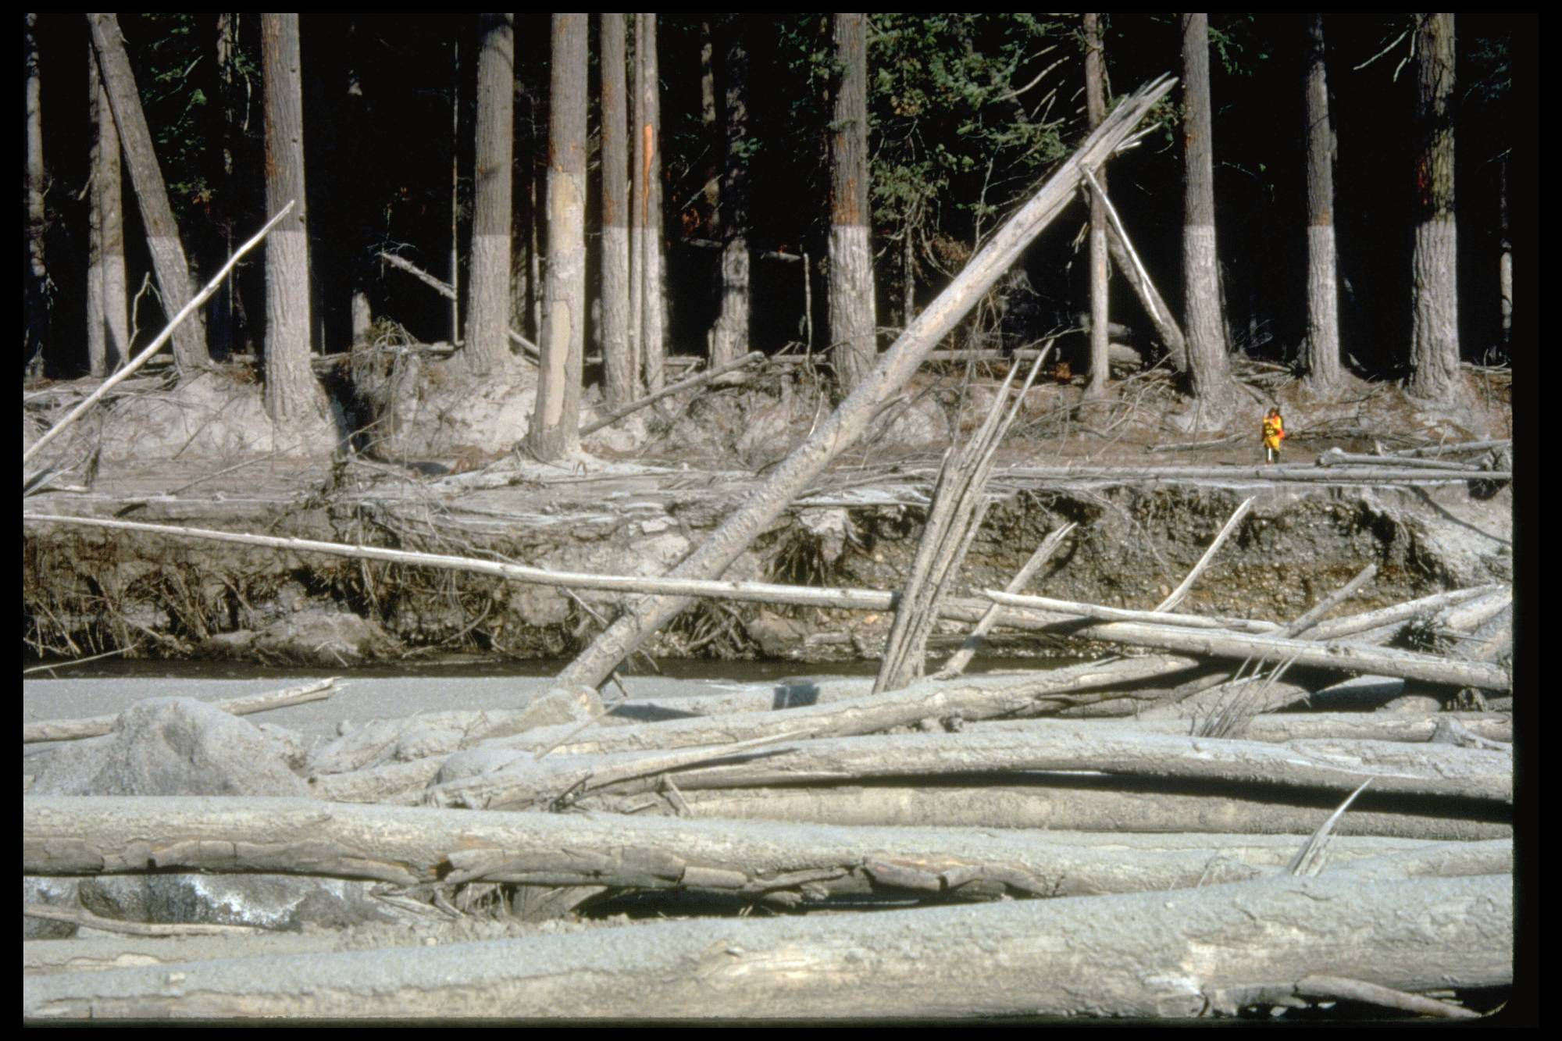
Lahar Deposit- Mount St. Helens

Slide 22
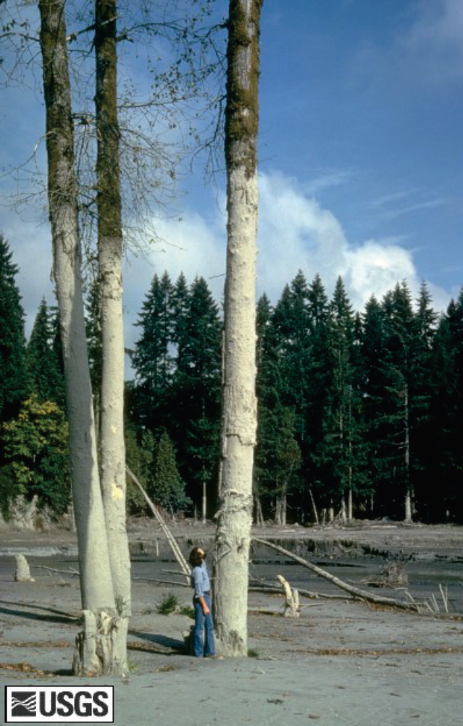
May 18, 1980 eruption of Mount St. Helens
Photograph taken by Lyn Topinka, U.S. Geological Survey, 1980

Slide 23
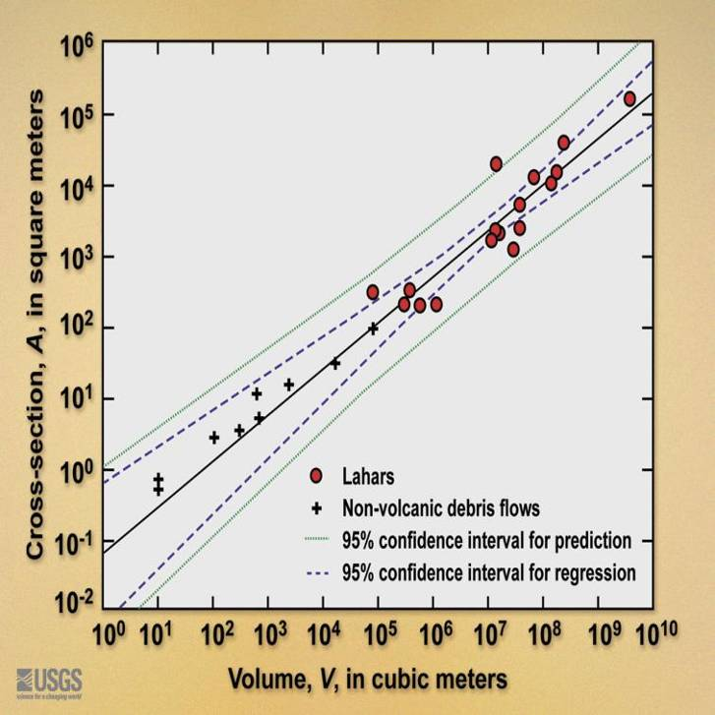
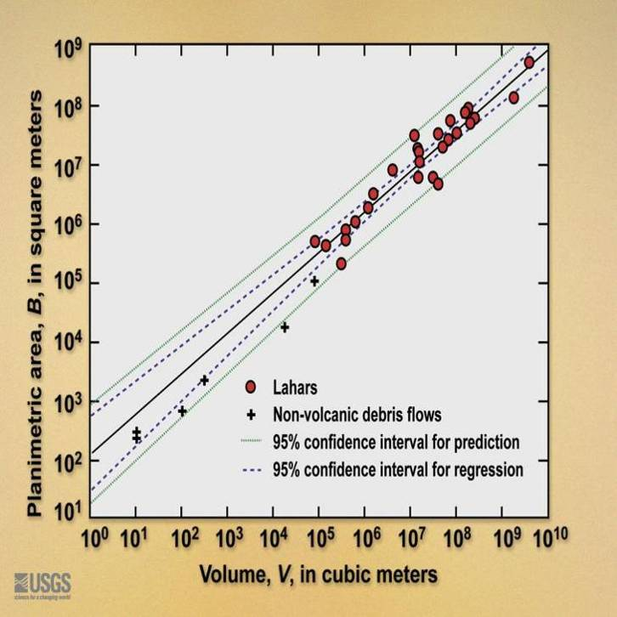
Cross-sectional area = c₁V ^{2/3}
r² =0.85
LAHARZ equations:
Use past events to forecast future events
Cross-sectional and planimetric area of inundation are proportional to flow volume^{2/3}
The coefficients c₁ and c₂ are determined from measuring the maximum cross-sectional area, planimetric area, and volume of many flows and performing regression analysis
Different flow types (lahars, rockfalls, debris flows) have different coefficients
Planimetric area = c₂V ^{2/3}
r² =0.90
Flow Type | C₁ | C₂
Lahars | 0.05 | 200
Debris flows | 0.1 | 20
Rockfalls | 0.2 | 20

Slide 24
Some key points about the LAHARZ equations:
Cross-sectional area = 0.05 V ^{2/3} and planimetric area = 200 V ^{2/3}
The calibrated values 0.05 and 200 reflect a specific data set
  in this case a group of 27 large lahars worldwide.
NOT deposit volume and area, rather maximum flow volume, inundation area, and maximum cross-sectional inundated area as determined from high-flow marks, hydrographs, flow observations, etc.
Values of the coefficients are specified to only one significant digit.
Predictions based on the equations have statistical uncertainty portrayed by confidence intervals
Error magnitudes are assumed to scale with V magnitudes --an assumption implicit in use of logarithmically transformed data and regression equations.

Slide 25
How does LAHARZ work?
r² =0.90
r² =0.85
Cross-sectional area = 0.05 V ^{2/3}
Planimetric area = 200 V ^{2/3}
From collected deposit data, determine the coefficients c₁ and c₂ for
Cross-sectional area = c₁V ^{2/3}
Planimetric Area = c₂V ^{2/3}

Slide 26
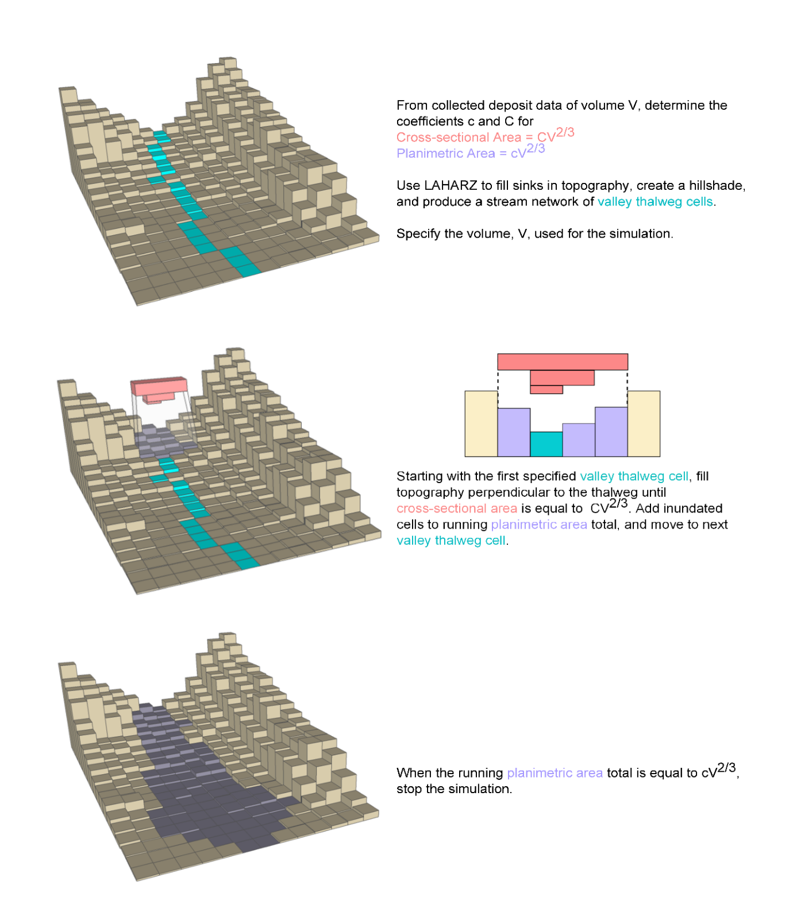
How does LAHARZ work?

Slide 27
How does LAHARZ work?
Cross-sectional area =0.05V^{2/3}
C₁V^{2/3}

Slide 28
How does LAHARZ work?
C₂V^{2/3}
Planimetric area =200V^{2/3}

Slide 29
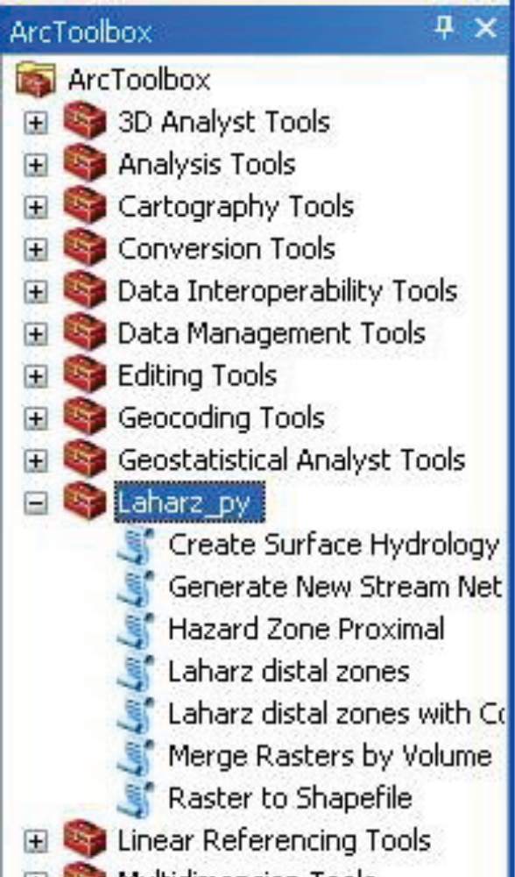
What do you need to run LAHARZ?
ArcGIS ArcMap 10.x
Laharz_py ArcGIS toolbox
Schilling et al. 2014
https://pubs.usgs.gov/of/2014/1073/
CSAV file folders

Slide 30
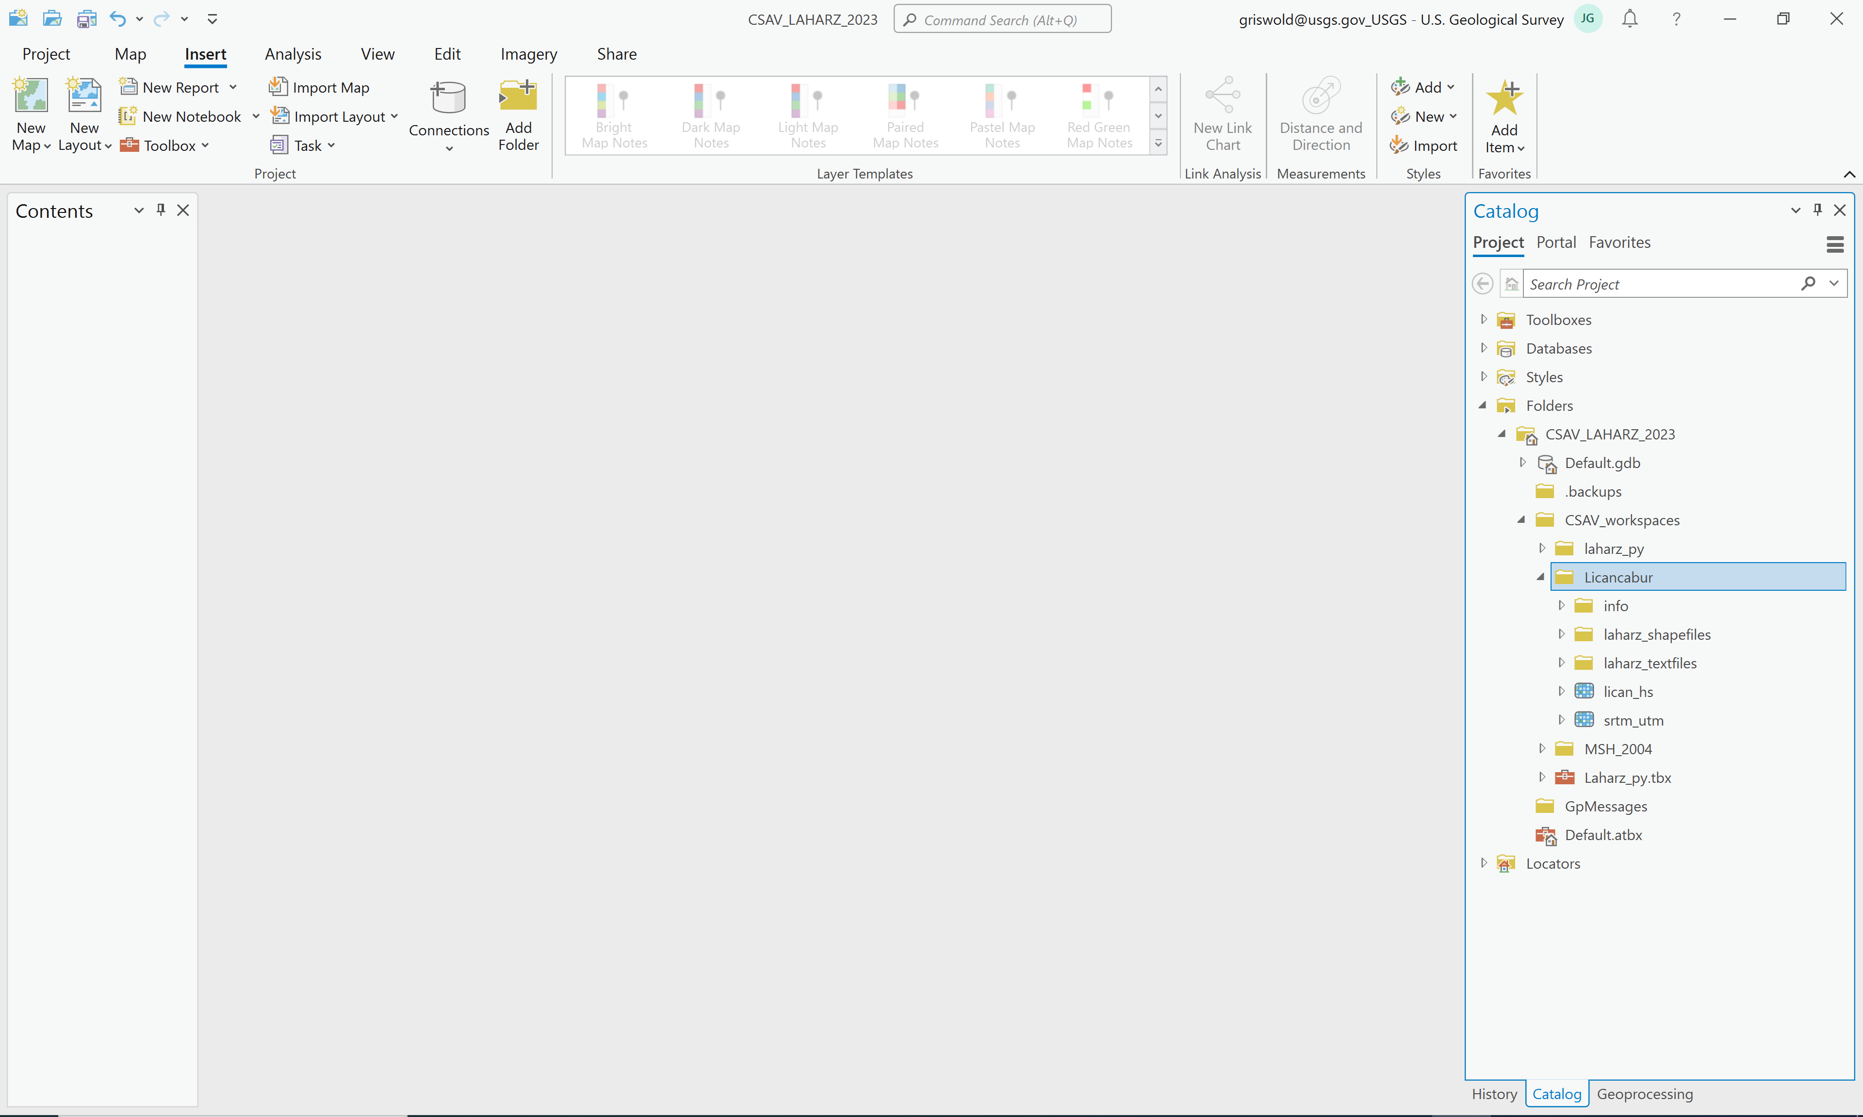
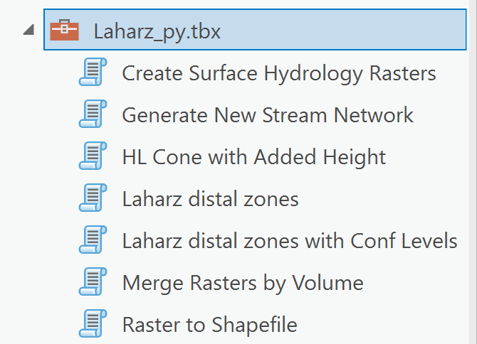
What do you need to run LAHARZ?
ArcGIS Pro
Julie Griswold 2023 rewrite of Schilling et al. 2014 code for ArcGIS Pro
Email me!
CSAV file folders

Slide 31
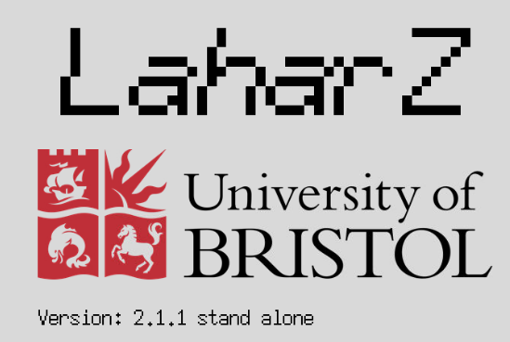
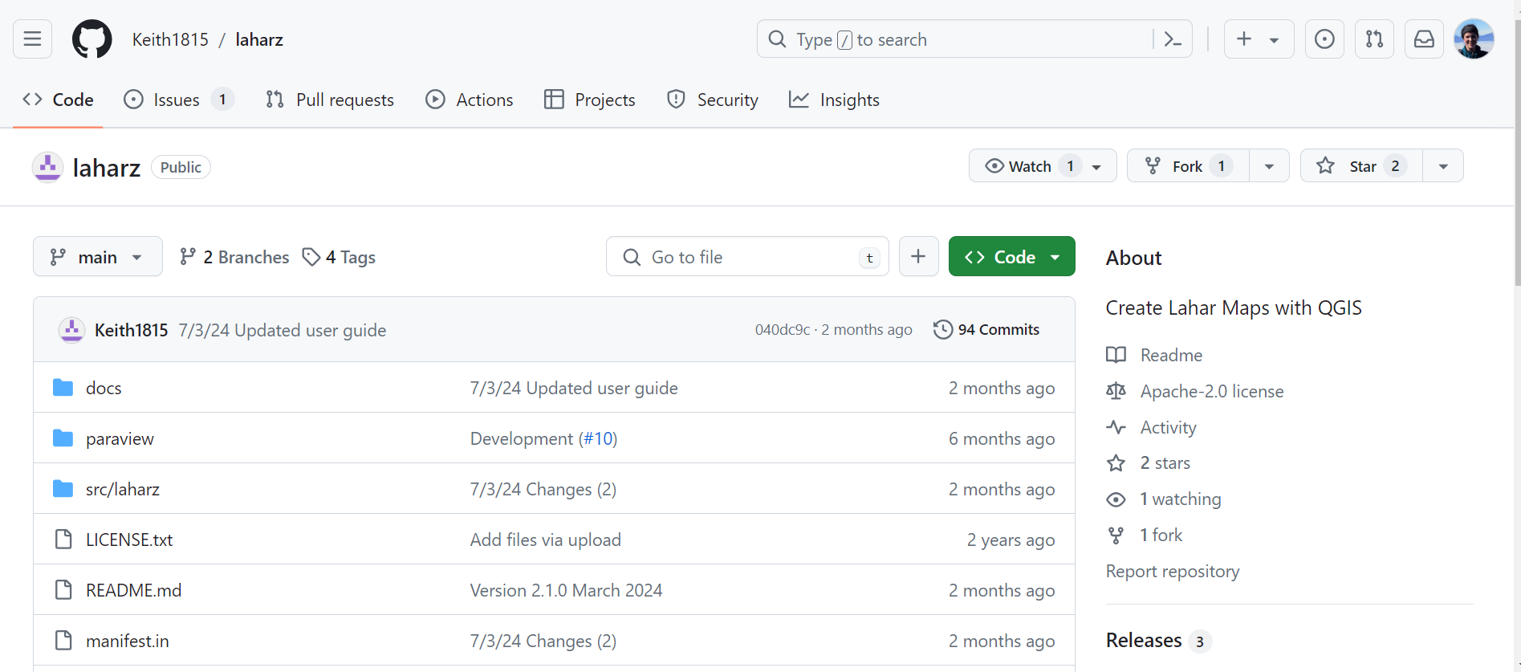
What do you need to run LAHARZ?
Keith Blair stand-alone python version
https://github.com/Keith1815/laharz

Slide 32

What do you need to run LAHARZ?
VICTOR platform (using QGIS and python-version of LAHARZ by Keith Blair)
https://victor.2i2c.cloud/
Nice because you don’t have to worry about installing python dependencies, so we’ll use it for class

Slide 33
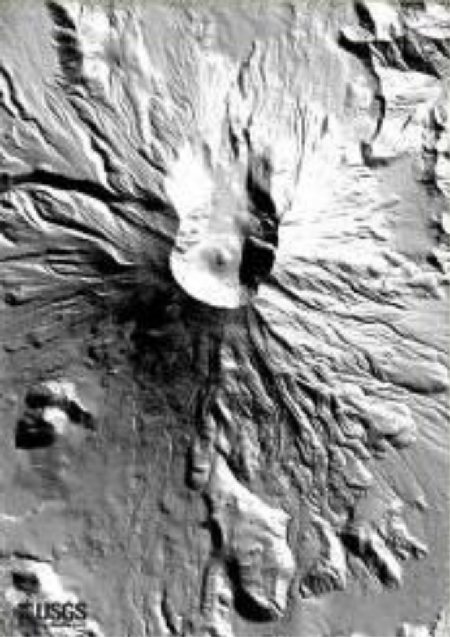
What do you need to run LAHARZ?
A Digital Elevation Model (DEM) that has an adequate extent (includes the volcano and drainages) and that accurately represents the hydrology

Slide 34
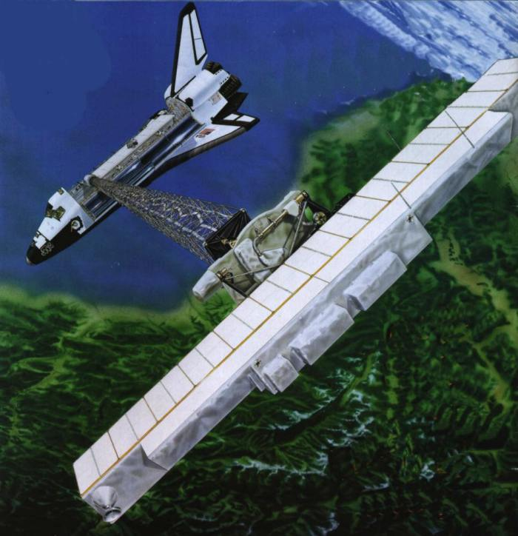
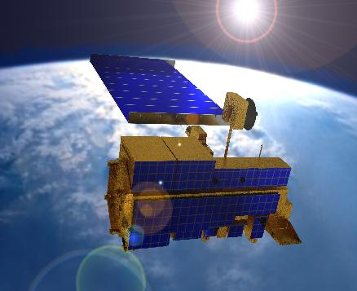

SRTM
Shuttle Radar Topography Mission
Survey for 11 days in February 2000
Radar “sees” through clouds
Data gaps: coastlines, mountains
60° N to 56° S
90-meter global dataset
Vertical error several meters
ASTER
Advanced Spaceborne Thermal Emission
and Reflection Radiometer (imagery instrument)
1.3 million images 1999-2009
Data gaps: persistent clouds
83° N to 83° S
30-meter global dataset
Vertical error (20m) & greater due to limited
ground control, especially mountains

Slide 35
What do you need to run LAHARZ?
A stream network
“Create surface hydrology rasters” and “Generate Stream Network” tools in ArcGIS LAHARZ, the “r.stream.extract” in QGIS, or the newest version of the standalone Python LAHARZ
Generates stream network using the DEM, and a user defined stream threshold
This is the number of upstream cells that have to flow into a cell to consider it a stream cell. A smaller number here will make a stream network with more branches and longer streams.
The network should generally match published maps, but should represent the *current* stream network

Slide 36
78 | 72 | 69 | 71 | 58 | 49
74 | 67 | 56 | 49 | 46 | 50
69 | 53 | 44 | 37 | 38 | 48
64 | 58 | 55 | 22 | 31 | 24
68 | 61 | 47 | 21 | 16 | 19
74 | 53 | 34 | 12 | 11 | 12
↘ | ↘ | ↘ | ↓ | ↓ | ↙
↘ | ↘ | ↘ | ↓ | ↓ | ↙
→ | → | ↘ | ↓ | ↙ | ↓
↗ | ↗ | → | ↘ | ↓ | ↙
↘ | ↘ | → | ↓ | ↓ | ↓
→ | → | → | → | ↓ | ←
0 | 0 | 0 | 0 | 0 | 0
0 | 1 | 1 | 2 | 2 | 0
0 | 3 | 7 | 5 | 4 | 0
0 | 0 | 0 | 20 | 0 | 1
0 | 0 | 0 | 1 | 24 | 0
0 | 2 | 4 | 7 | 35 | 1
Elevation (DEM)
Flow direction
Flow accumulation
0 | 0 | 0 | 0 | 0 | 0
0 | 1 | 1 | 2 | 2 | 0
0 | 3 | 7 | 5 | 4 | 0
0 | 0 | 0 | 20 | 0 | 1
0 | 0 | 0 | 1 | 24 | 0
0 | 2 | 4 | 7 | 35 | 1
0 | 0 | 0 | 0 | 0 | 0
0 | 1 | 1 | 2 | 2 | 0
0 | 3 | 7 | 5 | 4 | 0
0 | 0 | 0 | 20 | 0 | 1
0 | 0 | 0 | 1 | 24 | 0
0 | 2 | 4 | 7 | 35 | 1
Lower stream threshold: longer stream network with more branches
Higher stream threshold: shorter stream network with fewer branches
Stream threshold = 2
Stream threshold = 6

Slide 37
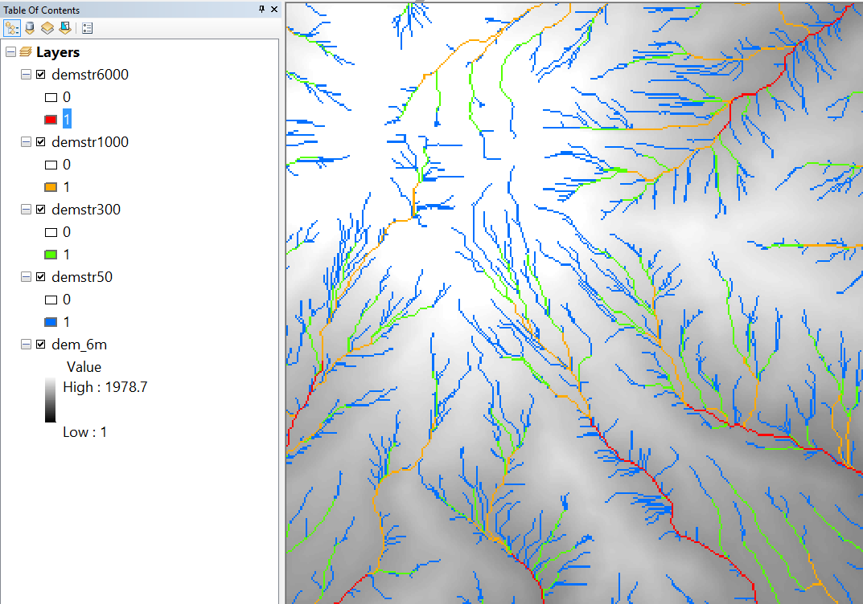
High stream threshold: shorter stream network with fewer branches
Low stream threshold: longer stream network with more branches

Slide 38
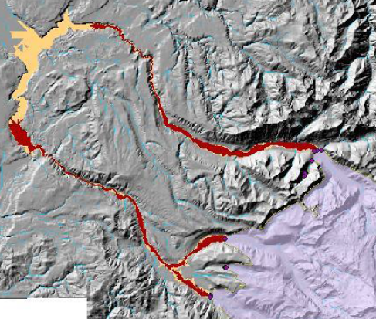
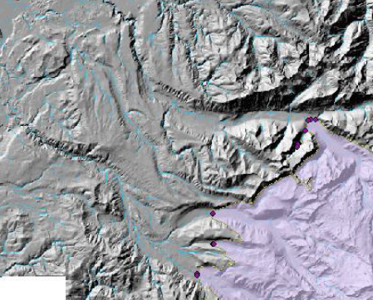
What do you need to run LAHARZ?
A starting location or locations:
  Use the proximal hazard zone tool within LAHARZ to produce an H/L cone that defines the starting locations (can edit these to have fewer points)
  Manually select starting locations

Slide 39
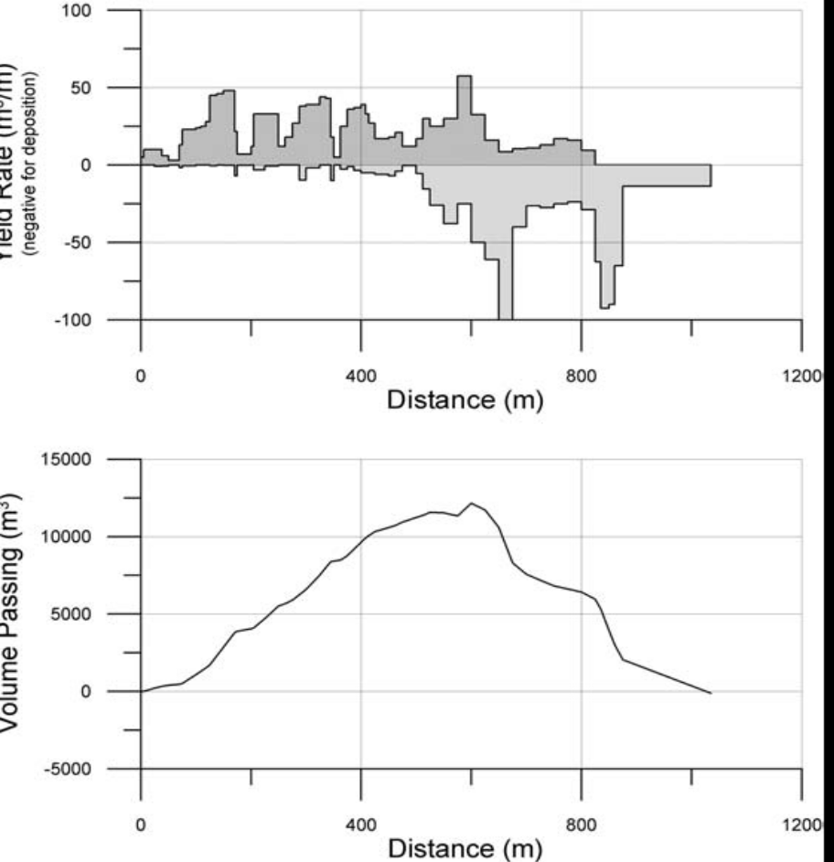
Proximal Hazard Zone for LAHARZ
Why use H/L Cone for lahars?
Lahars may initiate anywhere on the volcano edifice. We can’t know an exact start location in advance.
Loose pyroclastic flow deposits and ashfall are often the source material for lahars and are most abundant within the H/L cone.
Lahars gain volume (entrain material) on steep slopes.
Lahar Mass Balance Analysis
Volume peaks and declines
Volume
net erosion
net deposition
So, we start modeling lahars by estimating where on the flanks the flow volume is greatest.
We do this by defining an H/L cone that marks the transition between erosion and deposition. That is, inside the H/L cone, the volume is still increasing. Outside the H/L cone, the volume is maintained or decreasing (depositing).
How do we identify an H/L cone that represents this transition?
  from net erosion to net deposition
  from steep slopes to moderate slopes (20°-30°), that is, find the break in slope
  from pyroclastic debris fans to more channelized flows

Slide 40
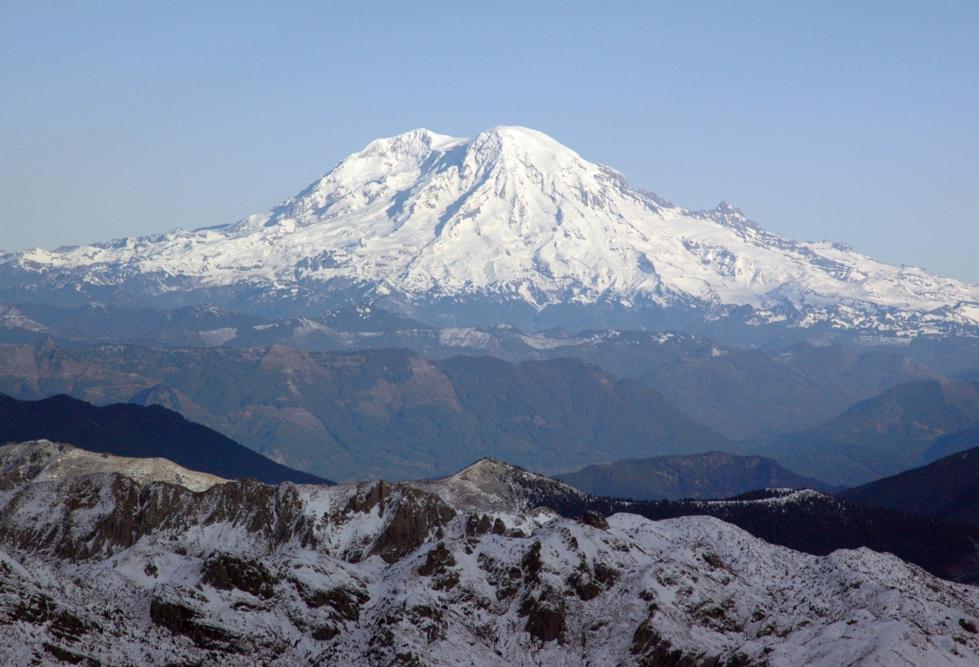
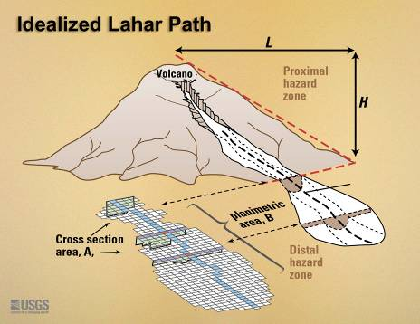
Mt. Rainier, west side
L
V
H
Begin flow hazard-zone computation where
deposition first exceeds erosion

Slide 41
Lahar hazard zones computed for Mt. Rainier with proximal
hazard zone defined by H/L = 0.23

Slide 42
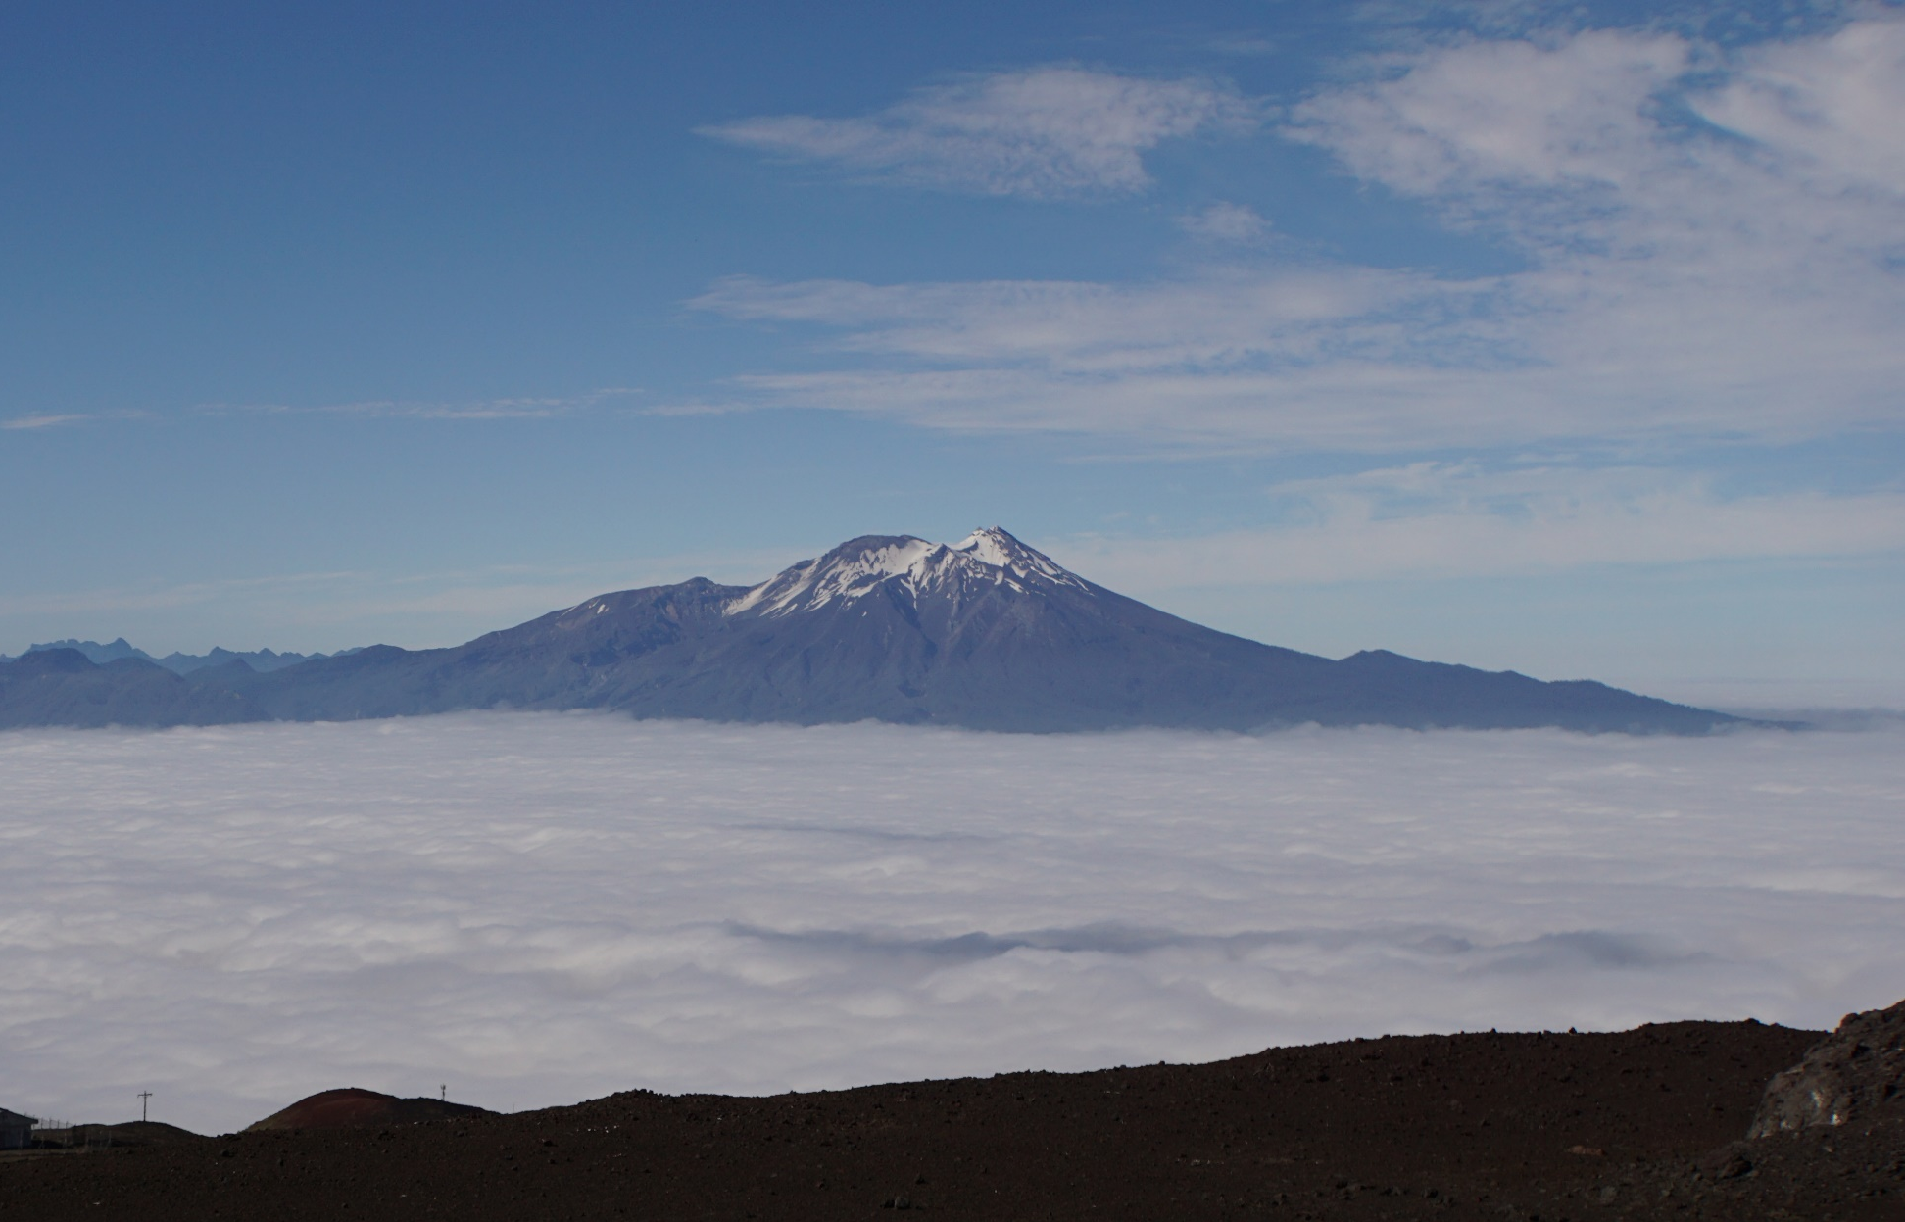
Special Cases: not a nice pointy volcano?

Slide 43
Special Cases: not a nice pointy volcano?
Add elevation in LAHARZ
250 m

Slide 44
What do you need to run LAHARZ?
A reasonable range of lahar volumes, considering volcano size, type, history, geology and the goal of the forecast (worst-case scenario vs. most-probable scenario)
Because of uncertainty and naturally occurring error in the regression equations, you should choose volumes that increase by at least 2x (1, 2, 4, 8, 16 million m³, for example)
Even better is to use values that increase by 10^{0.5} (1, 3, 10, 30, 100 million m³, for example)

Slide 45

The flow volume V of interest in LAHARZ is the maximum volume attained along the flow path... that is, the volume where the flow transitions from net erosion to deposition.
Vmax is defined where net
erosion changes to
net deposition
In real events V can change and evolve along the flow path, but this evolution is not considered in LAHARZ. In LAHARZ the volume of interest is the maximum volume that occurs during the course of flow.

Slide 46
Summary of key points
Documented inundation limits and flow volumes of past lahars provide the data for statistical forecasting of lateral and distal inundation limits for future lahars.
Lahar flow volume is the independent variable that must be specified by the user. Generally it’s best to posit a range of potential volumes and examine a range of possible outcomes.
A rationale must be adopted for establishing starting points for computing inundation limits. For volcanoes we typically use the intersection of H/L cones with valley thalwegs to establish starting points.
Hands-on session to try it out!

